Slide 1
Unlocking Python: Functions and Control Flow
Welcome to an exciting journey into the heart of Python programming! This presentation will guide you through the essentials of functions and control flow, empowering you to write more organized, efficient, and powerful code.

Slide 2
CHAPTER 3
Defining and Calling Functions
The first_two_lines() Function
The last_three_lines() Function
To kick things off, let's define a function called first_two_lines(). This function will use a repeating pattern to print eight instances of "Spam," simulating the first two lines of a song.
Next, we create last_three_lines(). This function will print "Spam" twice, then a unique phrase, and finally "Spam" two more times, completing the song segment.
def last_three_lines():
repeat(spam, 2)
print('(Lovely Spam, Wonderful Spam!)')
repeat(spam, 2)
def first_two_lines():
repeat(spam, 4)
repeat(spam, 4)
By calling first_two_lines(), you'll see "Spam, Spam, Spam, Spam, Spam, Spam, Spam, Spam" printed to your console.
Invoking last_three_lines() results in "Spam, Spam, (Lovely Spam, Wonderful Spam!) Spam, Spam".

Slide 3
Orchestrating Functions for a Complete Verse
Now, let's combine our smaller functions to print an entire verse of our song. This demonstrates how functions can work together in a structured way.
The print_verse() Function
Calling print_verse()
The print_verse() function orchestrates the calls to first_two_lines() and last_three_lines().
When print_verse() is called, it executes the entire sequence, printing:
def print_verse():
first_two_lines()
last_three_lines()
Spam, Spam, Spam, Spam,
Spam, Spam, Spam, Spam,
Spam, Spam,
(Lovely Spam, Wonderful Spam!)
Spam, Spam,
This hierarchical structure, where one function calls another, makes code easier to manage and understand, even though it could be achieved with fewer functions. It's all about illustrating how functions collaborate.

Slide 4
CONTROL FLOW
Repetition with for Loops
When you need to perform an action multiple times, Python's for loops come to the rescue. They provide a concise way to repeat a block of code a specified number of times.
Basic for Loop Structure
Printing Multiple Verses
Let's use a for loop to print our song verse twice, complete with verse numbers for clarity.
for i in range(2):
print(i)
for i in range(2):
print("Verse", i)
print_verse()
print()
The for statement defines the loop.
range(2) generates a sequence of numbers (0 and 1).
The body of the loop, indented by four spaces, executes for each number in the sequence.
This example will output:
01
This will neatly print "Verse 0" followed by the song, then "Verse 1" and the song again.

Slide 5
Encapsulating Repetition within Functions
Functions and loops are even more powerful when used together. You can embed a for loop inside a function to create reusable patterns of repetition.
The print_n_verses() Function
Consider the print_n_verses(n) function. It takes an integer n as a parameter, representing the number of verses to print.
def print_n_verses(n):
for i in range(n):
print_verse()
print()
Even if the loop variable i isn't directly used within the loop's body, its presence in the for header is mandatory.

Slide 6
SCOPE
Variables and Parameters: The Local Scope
Understanding variable scope is crucial for writing robust programs. In Python, variables defined inside a function have a limited "lifespan" and accessibility.
Local Variables
When you declare a variable within a function, it's considered local. This means it exists only while the function is executing. Once the function completes, the variable is destroyed.
def cat_twice(part1, part2):
cat = part1 + part2
print_twice(cat)
Here, cat is a local variable. If you try to access cat outside of cat_twice, Python will raise a NameError.
Parameters Are Also Local
Similarly, function parameters like part1 and part2 in the cat_twice example are also local to that function. They only hold their values within the function's scope and cannot be accessed from outside.
line1 = 'Always look on the '
line2 = 'bright side of life.'
cat_twice(line1, line2)
This code will correctly print the concatenated lines. However, attempting to print part1 or part2 after the function call would result in a NameError.

Slide 7
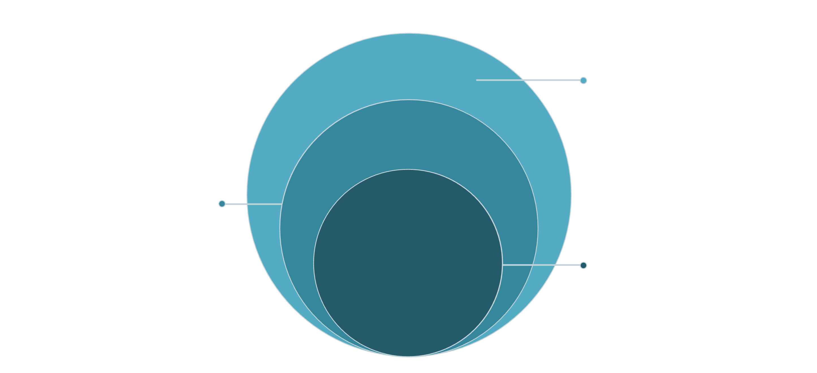
Visualizing Execution: Stack Diagrams
Stack diagrams offer a powerful visual aid for understanding function calls and variable scope. They map out the execution flow and the state of variables at different points in your program.
Top Frame
print_twice: string → print(? )
Next Frame
cat_twice: line1, line2, cat
Core Frame
__main__ (bottom of stack)
Each "frame" in the diagram represents a function call, containing its parameters and local variables. The stack illustrates the call hierarchy, with __main__ at the base, representing the main program execution.

Slide 8

DEBUGGING
Understanding Tracebacks
Errors are a natural part of programming. When a runtime error occurs, Python provides a traceback, which is an invaluable debugging tool. It's a map that shows you the sequence of function calls leading up to the error.
1
2
Error in print_twice()
Executing with the Error
Let's introduce an error into our print_twice() function by trying to print a non-existent variable cat.
When we call cat_twice(line1, line2) with this faulty print_twice, a traceback is generated.
def print_twice(string):
print(cat) # NameError
print(cat)
Traceback (most recent call last):
File :2 Cell In[21], line 3 in cat_twice
print_twice(cat)
Cell In[26], line 2 in print_twice
print(cat) # NameError
NameError: name 'cat' is not defined
The traceback reads from bottom to top, indicating the function where the error originated (print_twice), and then the function that called it (cat_twice), and so on. This mirrors the structure of a stack diagram, helping you pinpoint the problem.

Slide 9
The Power of Functions: Why Bother?
While they might seem like extra work at first, functions are fundamental to good programming practice. They offer numerous advantages that make your code clearer, more efficient, and easier to maintain.
Readability & Debugging
Eliminating Repetition
Functions allow you to name groups of statements, significantly improving code readability and simplifying the debugging process by breaking down complex problems.
Functions prevent "code duplication." If you need to change a piece of logic, you only update it in one place, reducing errors and saving time.
Modular Debugging
Code Reusability
Complex programs become manageable by dividing them into smaller, testable functions. You can debug each part independently before assembling the whole.
Well-designed functions are like building blocks. Once written and debugged, they can be reused across many different programs, boosting productivity.

